Slide 1
Computer Organization and Architecture
MIPS Architecture
Floating Point Number Representation
Conversion of C Programs to MIPS Assembly Language
Fall, 2020

Slide 2
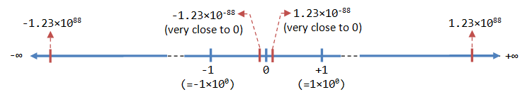
Floating-Point Number Representation
A floating-point number (or real number) can represent a very large (1.23×10^88) or a very small (1.23×10^-88) value.
It could also represent very large negative number (-1.23×10^88) and very small negative number (-1.23×10^88), as well as zero, as illustrated:

Slide 3
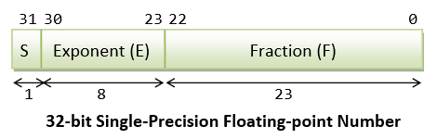
IEEE-754 32-bit Single-Precision Floating-Point Numbers
In 32-bit single-precision floating-point representation:
The most significant bit is the sign bit (S), with 0 for positive numbers and 1 for negative numbers.
The following 8 bits represent exponent (E).
The remaining 23 bits represents fraction (F).

Slide 4
Normalized Form
Let's illustrate with an example, suppose that the 32-bit pattern is 1 1000 0001 011 0000 0000 0000 0000 0000, with:
S = 1
E = 1000 0001
F = 011 0000 0000 0000 0000 0000
In the normalized form, the actual fraction is normalized with an implicit leading 1 in the form of 1.F. In this example, the actual fraction is 1.011 0000 0000 0000 0000 0000 = 1 + 1×2^-2 + 1×2^-3 = 1.375D.
The sign bit represents the sign of the number, with S=0 for positive and S=1 for negative number. In this example with S=1, this is a negative number, i.e., -1.375D.

Slide 5
In normalized form, the actual exponent is E-127 (so-called excess-127 or bias-127).
This is because we need to represent both positive and negative exponent. With an 8-bit E, ranging from 0 to 255, the excess-127 scheme could provide actual exponent of -127 to 128. In this example, E-127=129-127=2D.
Hence, the number represented is -1.375×2^2=-5.5D.

Slide 6
Summary
In summary, the value (N) is calculated as follows:
For 1 ≤ E ≤ 254, N = (-1)^S × 1.F × 2^(E-127). These numbers are in the so-called normalized form. The sign-bit represents the sign of the number. Fractional part (1.F) are normalized with an implicit leading 1. The exponent is bias (or in excess) of 127, so as to represent both positive and negative exponent. The range of exponent is -126 to +127.
For E = 0, N = (-1)^S × 0.F × 2^(-126). These numbers are in the so-called denormalized form. The exponent of 2^-126 evaluates to a very small number. Denormalized form is needed to represent zero (with F=0 and E=0). It can also represents very small positive and negative number close to zero.
For E = 255, it represents special values, such as ±INF (positive and negative infinity) and NaN (not a number). This is beyond the scope of this article.

Slide 7
Example 1
Suppose that IEEE-754 32-bit floating-point representation pattern is 0 10000000 110 0000 0000 0000 0000 0000.
Sign bit S = 0 ⇒ positive number
E = 1000 0000B = 128D (in normalized form)
Fraction is 1.11B (with an implicit leading 1) = 1 + 1×2^-1 + 1×2^-2 = 1.75D
The number is +1.75 × 2^(128-127) = +3.5D

Slide 8
MIPS Floating-Point Registers
The floating-point unit (called coprocessor 1) has 32 floating-point registers. These registers are numbered as $f0, $f1, …, $f31.
Each register is 32 bits wide.
Each register can hold one single-precision floating-point number.
• add.s $f0, $f1, $f2
• sub.s $f0, $f1, $f2
• mul.s $f0, $f1, $f2
• div.s $f0, $f1, $f2
• neg.s $f0, $f1

Slide 9
System Call Services for Floating-Point Numbers
Following syscall service numbers (passed in $v0) to print and read single-precision and double-precision floating-point numbers:
Service $v0 Arguments Result Print Float 2 $f12
Print Double 3 $f12
Read Float 6 Float is returned in $f0 Read Double 7 Double is returned in $f0

